Slide 1

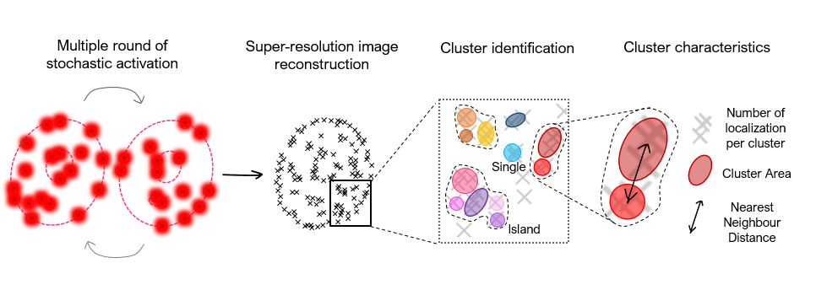
CLUSTER ANALYSIS
Visual instructions by Laura Martin, February 2022 1st 2022
STORM microscopy and cluster analysis for PcG studies
Laura Martin, Álvaro Castells-García, Maria Pia Cosma, and Maria Victoria Neguembor

Slide 2
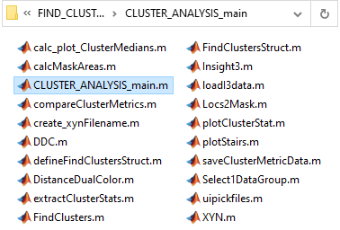
CLUSTER ANALYSIS
Original script from Carlo Manzo
Modified in the years by J Otterstorm, J Borbely, A Castells, & me
20 functions

Slide 3

CLUSTER ANALYSIS
Hierarchical code organization
>CLUSTER_ANALYSIS_main
Set analysis parameters
>defineClustersStruct
>FindClusterStruct
>FindClusters
>saveClusterMetricData
>extractClusterStats
>DistanceDualColor
Identifies Islands and clusters
Calculates clusters’ features:
n° localizations
Areas
NND (of In-Island only)
Calculates the global NND
between ALL clusters
Saves output files
(.xlsx, .mat, .bin, .dcc, .fig, .png)

Slide 4
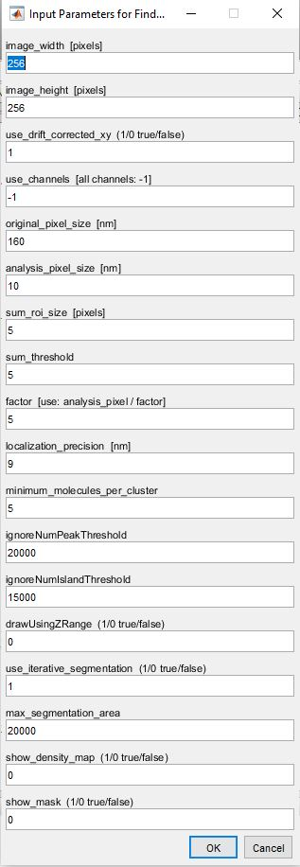
CLUSTER ANALYSIS
Dependent on Microscope/Camera settings
CRUCIAL FOR CLUSTER ANALYSIS
Optionals
(Particular conditions, plots…)

Slide 5
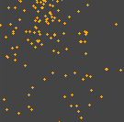
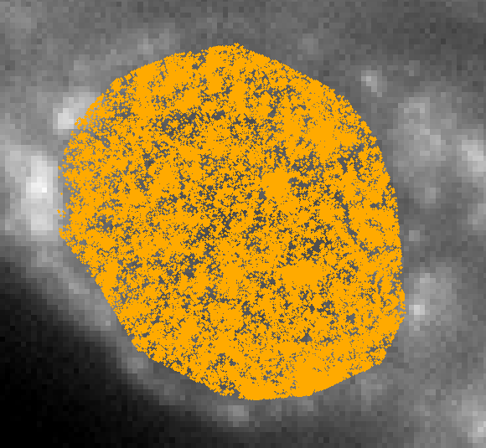
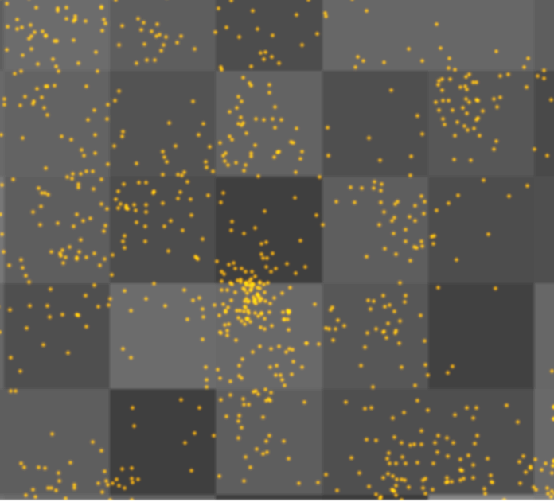
CLUSTER ANALYSIS
160nm
1
pixel

Slide 6

CLUSTER ANALYSIS
10 nm

Slide 7
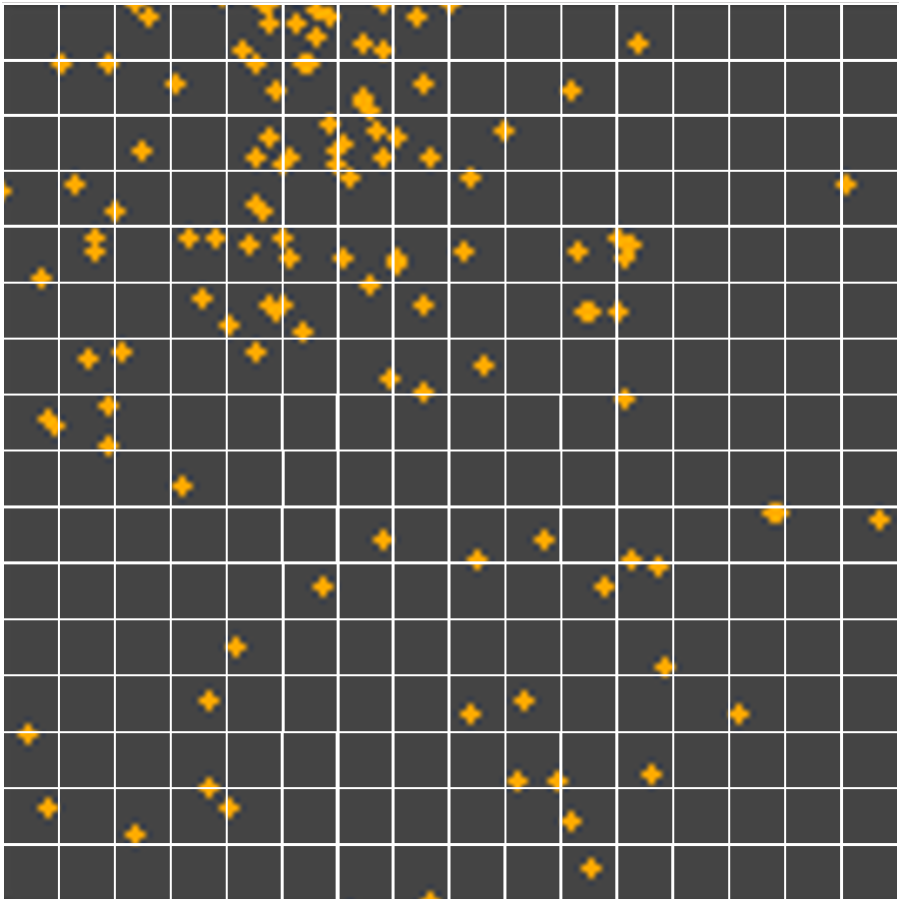
CLUSTER ANALYSIS
ISLAND
2
1
2
1
1
3
4
2
2
32
2
2
1
2
1
4
1
1
4
1
1
1
Empty
region

Slide 8
CLUSTER ANALYSIS
10 nm
ISLANDs identification

Slide 9
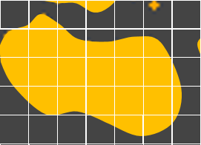
CLUSTER ANALYSIS
10 nm
It picks one Island

Slide 10
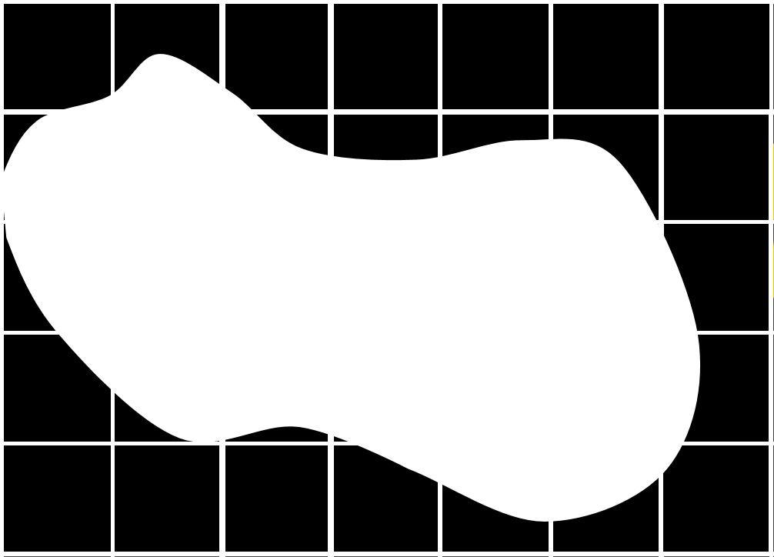
CLUSTER ANALYSIS
10 nm
It picks one Island

Slide 11
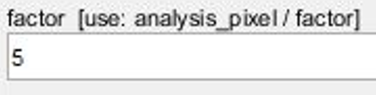
CLUSTER ANALYSIS
10 nm
2 nm
It picks one Island
It resizes it
10 nm : 5 = 2 nm

Slide 12
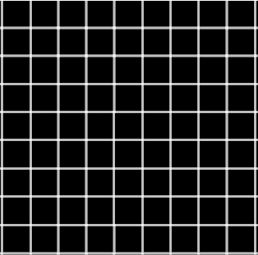
CLUSTER ANALYSIS
10 nm
2 nm
It picks one Island
It resizes it
For each localization:

Slide 13
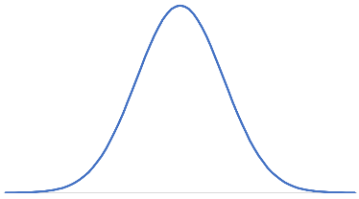
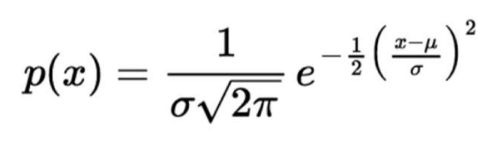
CLUSTER ANALYSIS
It picks one Island
It resizes it
For each localization:
It associates
a Gaussian curve

Slide 14
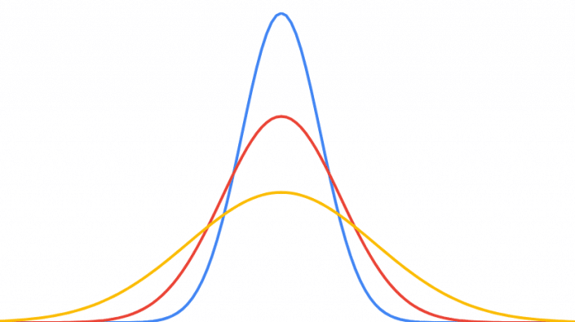
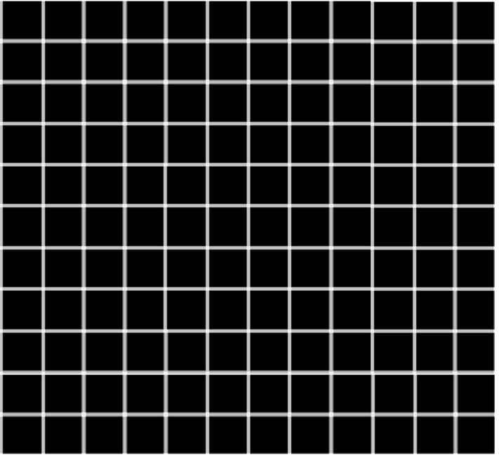

CLUSTER ANALYSIS
x, y localization coordinates
loc precision (9nm)
σ =
new analysis px (2nm)
.1
.1
.1
.1
.1
3σ
.35
.35
.35
.1
.1
roi size = numSigma*σ
.1
.5
.1
.35
.35
.1
.35
.1
.35
.35
.1
.1
.1
.1
.1

Slide 15
CLUSTER ANALYSIS
It picks one Island
It resizes it
For each localization:
It associates
a Gaussian curve
It sums the Gaussians to generate a density map
.1
.1
.1
.1
.1
New matrix of the summation of Gaussian values belonging to localizations
.35
.35
.35
.1
.1
.1
.5
.1
.35
.35
.1
.45
.1
.2
.35
.1
.1
.35
.35
.35
.45
.1
.2
.1
.1
.1
.1
.5
.1
.35
.35
.1
.35
.1
.35
.35
.1
.1
.1
.1
.1

Slide 16
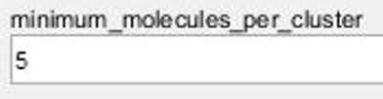
CLUSTER ANALYSIS
.1
.1
.1
.1
.1
In each Island,
from the density matrix
the Matlab function regionprops ‘magically’ identifies centroids
of clusters
.35
.35
.35
.1
.1
.1
.5
.1
.35
.35
.1
.45
.1
.2
.35
.1
.1
.35
.35
.35
.45
.1
.2
.1
.1
.1
.1
.5
.1
.35
.35
.1
.35
.1
.35
.35
.1
.1
.1
.1
.1
Then, the function lik_sig retrieves the Number of localizations belonging to each centroid, and the coordinates of the centroids in nm.
If the Number of localizations belonging to each centroid is
≥ minimum_molecules_per_cluster
a cluster is defined.

Slide 17
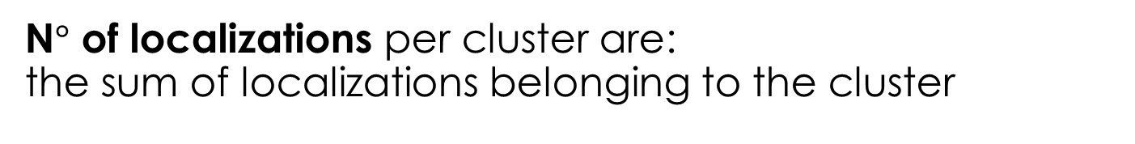


CLUSTER ANALYSIS
If region has
$$n° cluster>1$$
$$n° cluster =1$$
ISLAND
SINGLE cluster
N$°$ of localizations per cluster are: the sum of localizations belonging to the cluster
For each cluster, the algorithm calculates the coordinates X, Y of the CENTROID as: the mean of localizations coordinates (x, y)

Slide 18

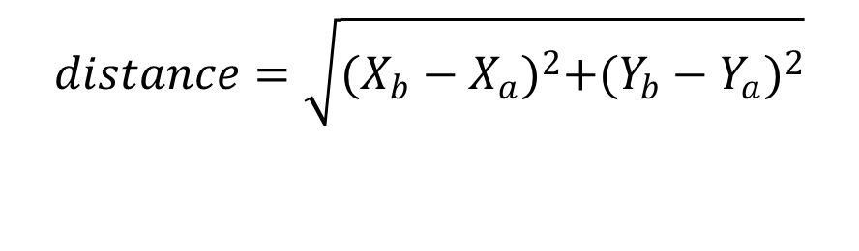
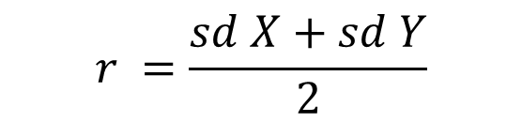
CLUSTER ANALYSIS
Area of the cluster is approximated to a circle, of which
To convert px to nm, simply *160 (original pixel size)
$$r =\frac{sd X+sd Y}{2}$$
$$A=πr^{2}$$
Inside each Island, distance among all cluster centroids (X, Y) is calculated, and the smallest distance between each pair of clusters is given in nm as NND
$$distance=\sqrt{{(X_{b}−X_{a})}^{2}+{(Y_{b}−Y_{a})}^{2}}$$
Of course, for Single clusters, NND will be ‘Infinite’ since for definition they have no close neighbours

Slide 19
CLUSTER ANALYSIS
To calculate NND among ALL clusters
>DistanceDualColor
NND is calculated using Centroids coordinates (X, Y) from EVERY cluster (InIsland and Single)
This script was originally made to calculate distances among different proteins (dual color).
For single color, the list of centroids is “doubled” and distances are calculated between the two identical lists. (distances = 0 are discarded.)

